Slide 1
Team Case Study
Rikmond Public Transportation
Tammy Bart
Crystal Bethea
Renzo Maguina
Elijah Thomas
Emmanuel Thomas

Slide 2
Introduction
A well facilitated passenger information system gives people the luxury of easy access to public transportation throughout the city of Rikmond, whether they currently use public transportation or not.
Up to date and reliable real-time information should be available to passengers before and during travel in order to enable anyone in the city to plan their trip door-to-door using a system that will provide them with appropriate departure times and routes from the beginning to the end of their journey. Additionally, passengers should be provided with schedules and network maps that are clear and coherent, real-time and mode specific arrival and departure times, timetable changes, detours and alternative routes.
All of this information should be available to passengers at any time via their mobile phones through the RCT app and SMS, through the telephone by Interactive Phone Response with the option to speak to a live representative, on touch screens at different locations throughout the city, on printed brochures, and via the internet

Slide 3
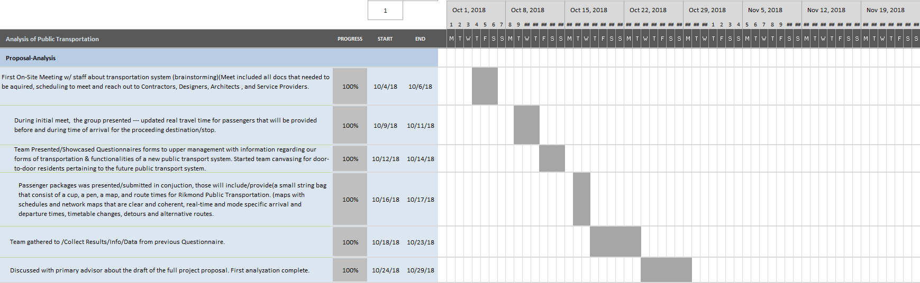
Gantt Chart
Proposal-Analysis

Slide 4
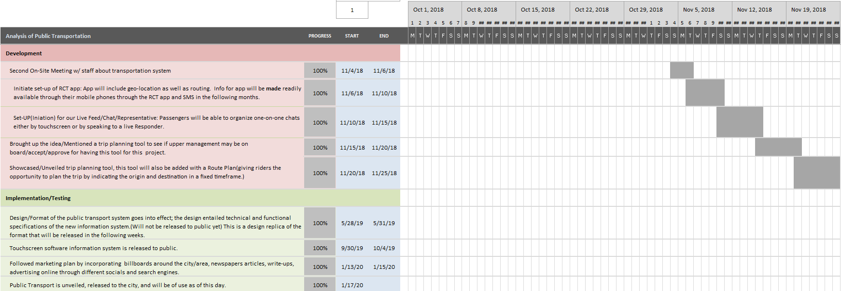
Development
Implementation & Testing

Slide 5
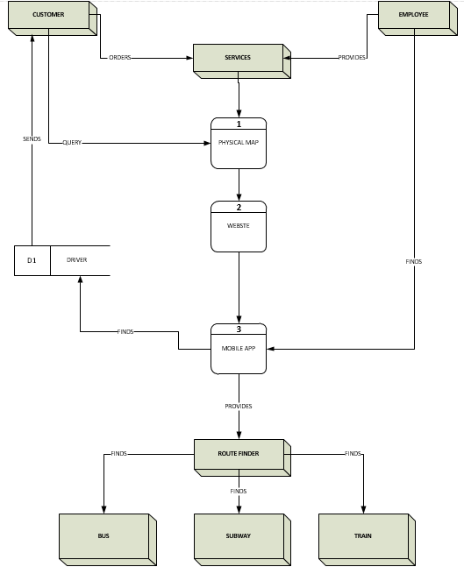
DFD Diagram

Slide 6
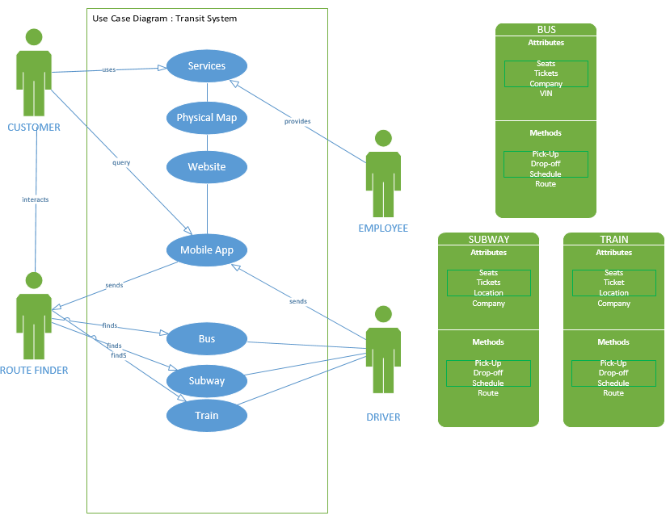
Use Case Diagram

Slide 7
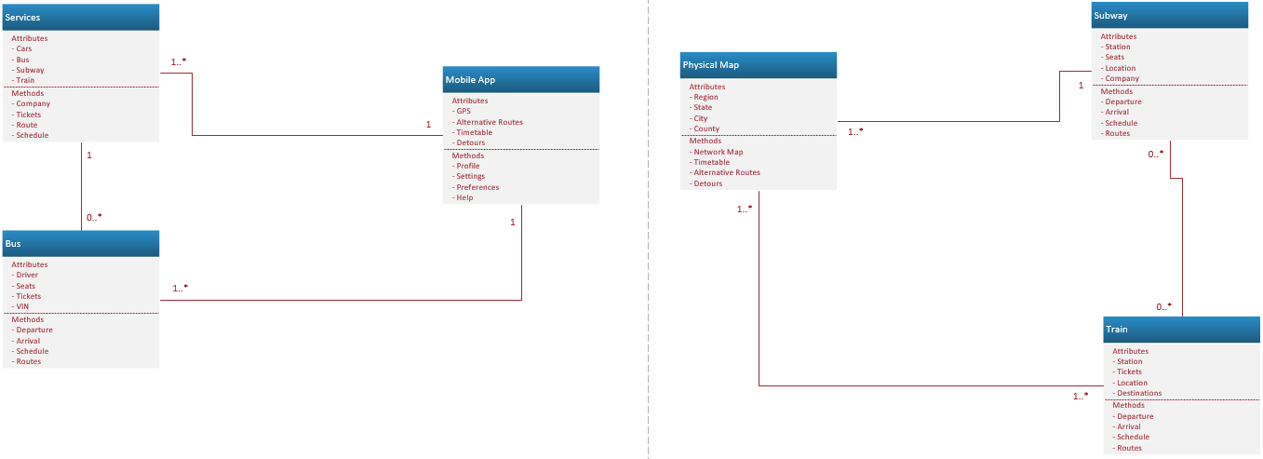
Class Diagram

Slide 8
Conclusion
Employees will be trained on the ins and outs of the mobile app, printed brochure and touch screens in order to be of help to users that are having trouble with any of these. It will also be ensured that employees are well versed in all different modes of public transportation.
The mobile app’s primary purpose is to be an avenue by which users can map out routes to their destinations via public transportation. The information is part of the RCT app. The brochure and touch screens are a simple map that shows all available routes of different methods of public transportation.

